Slide 1
Implementation of the Alumni Association platform for the University/Institute.
CSE7101- Capstone Project
Review-2
Batch Number: CSE_186
Under the Supervision of,
Dr./Mr./Ms./Prof. Mr.Gyanesh Verma
Professor / Associate Professor / Assistant Professor
School of Computer Science and Engineering
Presidency University
Roll Number | Student Name
20231CSE3033 | HARSHAN T N
20231CSE3065 | SRINIVAS R
20231CSE3068 | ABDUL RAHEEM ALI KHAN
Name of the Program: B. Tech
Name of the HoD: Dr. Asif Mohammed
Name of the Program Project Coordinator: Dr. Jayavadivel Ravi
Name of the School Project Coordinators: Dr. Sampath A K , Dr. Geetha A

Slide 2
Content
Abstract
Literature Survey
Objectives
Analysis Of Problem Statement
Comparison table
Proposed Method & Feasibility
Architecture Diagram
Modules
Hardware and Software Details
Time Line (Gantt Chart)
Expected Outcome
References

Slide 3
Abstract
Problem Statement
Alumni data is often scattered across social media platforms (LinkedIn, Facebook, WhatsApp).
Lack of a centralized system for managing alumni profiles, tracking career progress, and enabling student–alumni networking.
Institutions face difficulties in organizing reunions, events, and job postings.
Objectives
Develop a cross-platform solution:
A Web Portal (Admin + Alumni Dashboard) using PHP (Laravel framework).
A Mobile App (for alumni and students) using Flutter & Dart.
Integrate networking, job opportunities, success stories, geolocation, and real-time chat into one system.
Approach
Mobile-First Design ensuring alumni can access features via Android/iOS app.
Web Portal for administration, content management, and alumni verification.
Cloud-based Backend (MySQL/Firebase) for scalable, secure data management.

Slide 4
Literature Survey
Papers Reviewed (10+)
NLP-driven Alumni Portals (ICCS 2019).
AlmaHub: Alumni–Student Engagement Platform (I2CT 2023).
National University Alumni Portal (HNICEM 2023).
IntelliCampus: AI-Powered College Portal (ICKECS 2024).
Cloud-based Data Management for Universities.
Mobile-first Community Apps with Geolocation Features.
Social Networking Models for Professional Growth (LinkedIn case study).
Event-based Alumni Apps & User Engagement Studies.
Job Portal Integration with Academic Systems.
Privacy & Security Concerns in Alumni Networking Platforms.
Critical Analysis (based on Alumni Platforms only):
Most existing alumni portals focus on basic directory services (name, batch, contact).
Some provide event management, but lack real-time features like chat or location tracking.
Mobile accessibility is limited – majority are web-only portals.
Few integrate job postings and career support, and even when they do, the scope is limited to institutional jobs.
Security and alumni verification are often overlooked → risk of fake profiles.
Our platform is different: combines Web (Laravel) + Mobile (Flutter) with complete features (jobs, directory, success stories, events, chat, geolocation, push notifications).

Slide 5
Objectives
Primary Objectives
Centralized Alumni & Student Profiles.
Profile Management (update career details, achievements).
Networking Hub for alumni–student and alumni–alumni interaction.
Searchable Alumni Directory (skills, location, batch).
Job Portal for alumni job postings and student placements.
Success Stories to showcase alumni achievements.
Events & Reunions scheduling, registration, and notifications.
Location-Based Discovery (map integration).
Real-Time Chat & Push Notifications.
Mobile-Specific Objective
Ensure alumni engagement via Flutter-based mobile app with simple UI, fast access, and real-time updates

Slide 6
Analysis of Problem Statement
.
Existing Alumni Platforms (Examples from Universities/Research Papers):
AlmaHub (I2CT 2023): Web portal with alumni directory + events, but no mobile app and no geolocation.
National Alumni Portal (HNICEM 2023): Government-funded alumni data platform, but complex UI, limited engagement tools.
University-specific Portals (various IEEE/Scopus papers): Provide directory + donation management, but no networking/chat features.
Mobile Alumni Apps (2022 studies): Some provide event notifications, but no job integration or map-based alumni discovery.
Drawbacks of these Systems:
No all-in-one solution (each focuses only on one or two features).
Lack of cross-platform support (web + mobile).
Engagement is event-driven → alumni lose interest after reunions.
Missing career-oriented features (jobs, mentorship).
Poor scalability and security in many academic prototypes.

Slide 7
Comparison Table
.
Feature | AlmaHub (I2CT 2023) | National Alumni Portal (HNICEM 2023) | University Alumni Apps (various papers) | Our Project
Alumni Directory | ✅ Yes (basic) | ✅ Yes | ✅ Yes | ✅ Advanced (search by batch, skills, location)
Event Management | ✅ Yes | ✅ Yes | ✅ Limited | ✅ With notifications & RSVP
Job Portal / Career Support | ❌ No | ❌ No | ❌ Rare | ✅ Alumni post jobs, students apply
Mobile App | ❌ No (web only) | ❌ No (web only) | ✅ Some (limited) | ✅ Flutter app (Android )
Geolocation / Maps | ❌ No | ❌ No | ❌ No | ✅ Google Maps API “Find Alumni Near You”
Real-time Chat | ❌ No | ❌ No | ❌ No | ✅ One-to-one & group chat
Alumni Verification | ❌ No | ❌ No | ❌ Weak | ✅ Strong (admin approval + database)
Long-term Engagement | ❌ Event-driven only | ❌ Event-driven only | ❌ Limited | ✅ Continuous via chat, jobs, stories
Scalability & Cloud Support | ❌ Limited | ❌ Limited | ❌ Limited | ✅ Firebase + MySQL (cloud scalable)

Slide 8
Proposed Method & Feasibility
Proposed System
Mobile App (Flutter & Dart) → Alumni & Student Interface.
Web Portal (PHP + Laravel) → Admin Dashboard, Alumni Verification, Event & Job Posting Management.
Backend Database → MySQL + Firebase for data storage, authentication, notifications.
Feasibility Study
Technology Feasibility: Uses proven frameworks (Laravel + Flutter) and scalable backend (Firebase/MySQL).
Economic Feasibility: Open-source tools minimize cost; only hosting & API costs required.
Operational Feasibility: Easy adoption with user-friendly mobile UI and web-based administration.

Slide 9
Architecture Diagram
System Flow:
Mobile App (Flutter)
Alumni Login / Student Login
Access features: Profile, Jobs, Events, Directory, Chat, Maps
Web Portal (Laravel)
Admin Panel: Alumni Verification, Job Approvals, Event Management, Analytics
Backend Services
Database (MySQL + Firebase Firestore)
APIs (REST APIs via Laravel + Firebase SDKs)
Google Maps API (location-based alumni discovery)
Firebase Cloud Messaging (push notifications)

Slide 10
Modules
Authentication & Profile Management
Login/Register, alumni verification.
Alumni Directory
Search by batch, location, expertise.
Networking Hub
Alumni–Student connections, group creation.
Job Portal
Alumni post jobs, students apply via app.
Success Stories
Alumni share achievements, inspiring juniors.
Events & Reunions
Schedule, RSVP, notifications.
Location-Based Alumni Finder
Google Maps API → “Find alumni near you”.
Real-Time Chat System
1-to-1 chat & group chat (Firebase/Socket.IO).
Admin Dashboard (Web)
Content moderation, alumni approval, analytics.

Slide 11
Hardware & Software Details
Hardware Requirements
Server / Cloud Hosting (AWS / Google Cloud / Firebase).
End-user devices: Smartphones (Android/iOS), PCs for web admin.
Software Requirements
Frontend (Mobile): Flutter, Dart.
Frontend (Web): PHP, Laravel, HTML/CSS/JS.
Backend: Laravel APIs, Firebase SDK.
Database: MySQL + Firebase Firestore.
APIs: Google Maps API, Firebase Cloud Messaging.
Tools: Android Studio, VS Code, Postman, GitHub.

Slide 12
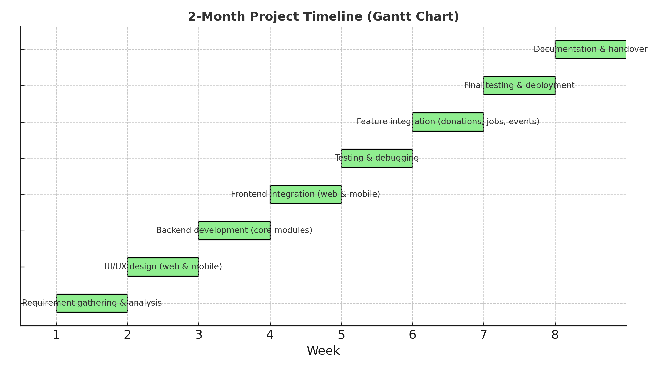
Timeline (Gantt Chart)

Slide 13
Expected Outcomes
Fully functional Alumni Mobile App (Flutter) for Android
Web-based Admin Portal (Laravel) for university management.
Secure Alumni Data Management with verification system.
Career support via integrated job portal.
Enhanced alumni–student interaction via chat & networking hub.
Improved alumni engagement with location-based discovery & event management.

Slide 14
References
[1] S. Q. Sabri, A. M. Ahmad, and M. B. Abdulrazaq, “Design and Implementation of Student and Alumni Web Portal,” Science Journal of University of Zakho, vol. 5, no. 3, pp. 272–277, Sept. 2017, doi: 10.25271/2017.5.3.395.
[2] S. Rajini, H. P. B., and U. A., “Alumni Management and Networking System,” in Proc. 2nd Int. Conf. Advancements in Electrical, Electronics, Communication, Computing and Automation (ICAECA), Coimbatore, India, 2023, pp. 1–5, doi: 10.1109/ICAECA56562.2023.10200060.
[3] M. B. et al., “Design of Alumni Portal With Data Security,” in Proc. 2nd Int. Conf. Electronics and Sustainable Communication Systems (ICESC), Coimbatore, India, 2021, pp. 1–7, doi: 10.1109/ICESC51422.2021.9532986.
[4] A. Induja, R. Robsi, and B. Latha, “Alumni Mentorship Portal Using Cloud Computing,” in Proc. 1st Int. Conf. Computational Science and Technology (ICCST), Chennai, India, 2022, pp. 1–5, doi: 10.1109/ICCST55948.2022.10040315.
[5] A. A. Shinu et al., “Customized Alumni Portal implementing Natural Language Processing Techniques,” in Proc. Int. Conf. Intelligent Computing and Control Systems (ICCS), Madurai, India, 2019, pp. 927–931, doi: 10.1109/ICCS45141.2019.9065320.
[6] S. S. Patil et al., “AlmaHub: An Engaging, Supportive Alumni-Students Interaction Platform,” in Proc. IEEE 8th Int. Conf. Convergence in Technology (I2CT), Lonavla, India, 2023, pp. 1–6, doi: 10.1109/I2CT57861.2023.10126226.
[7] A. D. Lacasandile et al., “Fostering Alumni Involvement and Professional Advancement: A User-Centric Perspective on the National University Alumni Portal,” in Proc. IEEE 15th Int. Conf. Humanoid, Nanotechnology, IT, Communication and Control, Environment, and Management (HNICEM), Coron, Philippines, 2023, pp. 1–6, doi: 10.1109/HNICEM60674.2023.10589170.
[8] P. Mithun, R. D. Kumar, and S. Dikshit, “IntelliCampus: AI-Powered College Portal with Auto-Scheduler and News Sharing,” [Online]. Available: RSPScienceHub, 2024.
[9] S. M. Rubejes-Silva, “Bridging the Gap Between Universities and Alumni: A User-Centered Evaluation of a Digital Alumni Engagement Platform,” Journal of Innovative Technology Convergence, vol. 6, no. 2, 2024, doi: 10.69478/JITC2024v6n002a05.
[10] V. S. Krishna et al., “Alumni Student Interconnect System,” Int. J. Innovative Research in Technology, vol. 11, no. 11, pp. 7860–7864, Apr. 2025.

Slide 15


